Slide 1
How to fine-tune a Large Language Model
Durgesh Gupta

Slide 2
KnolX Etiquettes
Lack of etiquette and manners is a huge turn off.
Punctuality
Join the session 5 minutes prior to the session start time. We start on time and conclude on time!
Feedback
Make sure to submit a constructive feedback for all sessions as it is very helpful for the presenter.
Silent Mode
Keep your mobile devices in silent mode, feel free to move out of session in case you need to attend an urgent call.
Avoid Disturbance
Avoid unwanted chit chat during the session.

Slide 3
What is Fine-tuning
Pre-trained Model Vs Fine-tuned Model
What is Pre-training?
Limitation of pre-trained base models
Advantage of fine-tuning your own LLM
What is Instruction fine-tuning
Data Preparation
Approach to fine-tuning
PEFT: Parameter Efficient fine-tuning
Error Analysis
Sample Training Code

Slide 4
01
What is fine-tuning?

Slide 5
What is Fine-tuning?
Finetuning is tweaking the model’s parameters to make it suitable for performing a specific task.
We can fine-tune a pre-trained model or in simple words, train to perform a specific task such as sentiment analysis, text generation, finding document similarity, etc.
What fine-tuning does for the model?
Gets model to learn the data, rather than just get access to it.
Steers the model to more consistent outputs
Reduce hallucinations
Customizes the model to a specific use case.

Slide 6
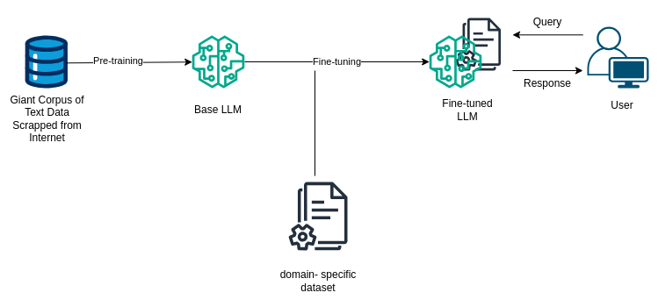
What is Fine-tuning?

Slide 7
02
Pre-trained Model Vs Fine-Tuned Model

Slide 8
Pre-trained Model Vs Fine-tuned Model
Pre-trained Model
Fine-tuned Model
No data to get started
Smaller upfront cost
No technical/training knowledge
Connect data through retrieval (RAG)
More Generic data fits
Hallucinations
RAG misses or gets incorrect data.
Domain specific data required
Involves Upfront compute cost
Needs technical expertise.
Use RAG too (More Secure)
More high-quality domain specific data
Learn new information
Able to correct incorrect information
Note: Less cost afterwards if smaller model

Slide 9
03
Training/Pre-training

Slide 10
Training Model to learn text-generation
Training LLMs from scratch is known as pre-training.
It is a technique in which a large language model is trained on a vast amount of unlabeled text.
Utilizing the concept of Self-Supervised Learning, model masks a word and tries to predict the next word with the help of the preceding words.
Pre-training, it is a technique in which the model learns to predict the next word in the text.
Example: I am a data scientist.
The model can create its own labeled data from this sentence like:
Text | Label
I | am
I am | a
I am a | data
I am a data | scientist

Slide 11
04
Limitation of Pre-trained Base Model

Slide 12
Limitation of Pre-trained Model
Contextual Understanding: Difficult differentiating context.
Generating Misinformation: May generate incorrect or misleading information.
Lack of Creativity: Creativity based on mimicking patterns.
Hallucination: Generates text that is erroneous, nonsensical, or detached from reality.

Slide 13
05
Benefits of fine-tuning your own LLM

Slide 14
Benefit of fine-tuning your own LLM
Performance
Less Hallucination
Increase Consistency
Reduce unwanted information
Privacy
On Prem
Prevent Leakage
No breaches
Reliability
Control Uptime
Lower Latency
Increased Transparency
Greater Control

Slide 15
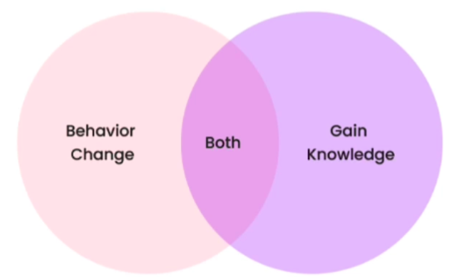
Impact of fine-tuning on the model
Behavior Change
Learning to respond more consistently
Learning to focus, e.g., moderation
Teasing out capability, e.g., better at conversation
Gain Knowledge
Increasing knowledge of new specific concepts.
Correcting old incorrect information

Slide 16
06
Instruction Fine-tuning

Slide 17
What is instruction fine-tuning?
Instruction fine-tuning is a specialized technique to tailor large language models to perform specific tasks based on explicit instructions.
It refers to the process of further training LLMs on a dataset consisting of instruction, output pairs in a supervised fashion, which bridges the gap between the next-word prediction objective of LLMs and the users' objective of having LLMs adhere to human instructions.
Teaches model to behave more like a chat bot.
Better user interface for model interaction
Increased AI adoption, from the thousands of researchers to million of people
Can access model pre-existing knowledge.

Slide 18


Instruction following datasets
Some existing data is ready as-in online:
FAQ's
Customer Support Conversation
Slack Messages

Slide 19
07
Data Preparation

Slide 20
Data Selection Criteria
Better
Worse
Higher Quality
Diversity
Real
More
Lower Quality
Homogeneity
Generated
Less

Slide 21
Steps to prepare your data
Collect instruction-response pairs
Concatenate pairs (add prompt template, if required)
Tokenization: Pad, Truncate
Split into train/test

Slide 22
Tokenization
Tokenization is the process of splitting text into individual units, typically words or sub words.
This step is crucial for the model to understand the structure of the text.
In languages like English, tokenization is relatively straightforward, as words are typically separated by spaces.

Slide 23
Tokenization
This is an input text.
ENCODING
[CLS] | This | is | an | input | text | . | [SEP]
101 | 2023 | 2003 | 1037 | 7953 | 2058 | 1012 | 102

Slide 24
08
Approach To fine-tuning

Slide 25
Approach To Fine-tune LLM
The steps for fine-tuning the Large Language Model are:
Figure out the task.
Data collection related to the task: input/output pairs.
Data generation, if required
Fine tune a small model e.g., 50M-1B
Vary the amount of data you give your model.
Evaluate the model performance.
Collect more data to improve.
Increase task complexity
Increase the model size for performance.

Slide 26
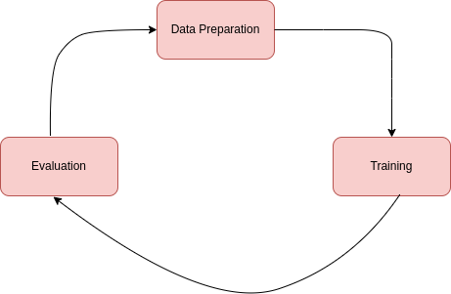
Fine-tuning Lifecycle

Slide 27
09
PEFT: Parameter Efficient Fine-tuning

Slide 28
PEFT: Parameter Efficient Fine Tuning
PEFT stands for Parameter Efficient Fine-tuning.
ML models are essentially complex mathematical equations with numerous coefficients or weights.
These coefficients are responsible for the model behavior and make it capable of learning from data.
During training of ML models, we adjust these coefficients to minimize errors and make accurate predictions.
In case of LLMs, which can have billions of parameters, and changing all of them during training can be computationally expensive and memory-intensive.
PEFT, as a subset of fine-tuning, takes the parameter efficiency seriously.
Instead of altering all the coefficients of the model, PEFT selects a subset of them.
It helps us significantly reducing the computational and memory requirements.

Slide 29
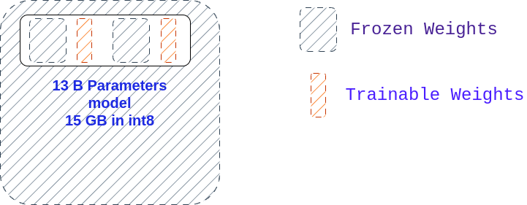
PEFT: Parameter Efficient Fine Tuning

Slide 30
PEFT: Parameter Efficient Fine Tuning
LoRA and QLoRA for Coefficient Selection
LoRA (Low-Rank Adoption):
It is a technique exploits the fact that some weights have more significant impacts than others. In LoRA, the large weight matrix is divided into two smaller matrices by factorization.
We reduce the number of coefficients that need adjustment, making the fine-tuning process more efficient.
QLoRA (Quantization + Low-Rank Adoption):
Quantization involves converting high-precision floating-point coefficients into lower-precision representations, such as 4-bit integers.
Quantization offers a solution by reducing the precision of these coefficients.
For instance, a 32-bit floating-point number can be represented as a 4-bit integer within a specific range. This conversion significantly shrinks the memory footprint.

Slide 31
10
Error Analysis

Slide 32
Evaluating Generative AI model
Evaluating Generative Models are Notoriously difficult !
Huaman Evaluation: Human Expert Evaluation is most reliable.
Test Data- Good test data is crucial
High Quality
Accurate
Generalize
Not seen in training data
Elo Rankings
Ranking of the top LLMs based on their Elo scores.
The Elo scores are computed from the results of A/B tests, wherein the LLMs are pitted against each other in a series of games.
The ranking system employed is based on the Elo Rating System.

Slide 33
Error Analysis
Understand the base model behaviour before finetuning
Categorize errors: iterate on data to fix these problems in data.
Category | Example with Problem | Example Fixed
Misspelling | Your kidney is healthy, but you lever is sick, get your lever examined | Your kidney is healthy, but your liver is sick
Too Long | Diabetes is less likely when you eat a healthy diet makes diabetes less likely, making …...... | Diabetes is less likely when you eat a healthy diet
Repetitive | Medical LLMs can save healthcare workers time and money and time and money and time and money. | Medical LLMs can save healthcare workers time and money

Slide 34
11
Sample Training Code

